Slide 1
Lecture 5
Advanced SQL and
Other Relational Query Languages

Slide 2
Outline
Accessing SQL From a Programming Language
Functions and Procedural Constructs
Triggers
Other Relational Query Languages

Slide 3
Accessing SQL From a Programming Language
API (application-program interface) for a program to interact with a database server
Application makes calls to
  Connect with the database server
  Send SQL commands to the database server
  Fetch tuples of result one-by-one into program variables
Various tools:
  ODBC (Open Database Connectivity) works with C, C++, C#, and Visual Basic. Other API’s such as ADO.NET sit on top of ODBC
  JDBC (Java Database Connectivity) works with Java
  Embedded SQL

Slide 4
Prepared Statement
PreparedStatement pStmt = conn.prepareStatement(
"insert into instructor values(?,?,?,?)");
pStmt.setString(1, "88877");
pStmt.setString(2, "Perry");
pStmt.setString(3, "Finance");
pStmt.setInt(4, 125000);
pStmt.executeUpdate();
pStmt.setString(1, "88878");
pStmt.executeUpdate();
WARNING: always use prepared statements when taking an input from the user and adding it to a query
  NEVER create a query by concatenating strings
  "insert into instructor values(’ " + ID + " ’, ’ " + name + " ’, " + " ’ + dept name + " ’, " ’ balance + ")“

Slide 5
SQL Injection
Suppose query is constructed using
  "select * from instructor where name = ’" + name + "’"
Suppose the user, instead of entering a name, enters:
  X’ or ’Y’ = ’Y
then the resulting statement becomes:
  "select * from instructor where name = ’" + "X’ or ’Y’ = ’Y" + "’"
  which is:
    select * from instructor where name = ’X’ or ’Y’ = ’Y’
  User could have even used
    X’; update instructor set salary = salary + 10000; --
Prepared statement internally uses:
"select * from instructor where name = ’X\’ or \’Y\’ = \’Y’
  Always use prepared statements, with user inputs as parameters

Slide 6
Transaction Control in JDBC
By default, each SQL statement is treated as a separate transaction that is committed automatically
  bad idea for transactions with multiple updates
Can turn off automatic commit on a connection
  conn.setAutoCommit(false);
Transactions must then be committed or rolled back explicitly
  conn.commit(); or
  conn.rollback();
conn.setAutoCommit(true) turns on automatic commit.

Slide 7
JDBC Resources
JDBC Basics Tutorial
  https://docs.oracle.com/javase/tutorial/jdbc/index.html

Slide 8
Embedded SQL
The SQL standard defines embeddings of SQL in a variety of programming languages such as C, C++, Java, Fortran, and PL/1,
A language to which SQL queries are embedded is referred to as a host language, and the SQL structures permitted in the host language comprise embedded SQL.
The basic form of these languages follows that of the System R embedding of SQL into PL/1.

Slide 9
Embedded SQL
The EXEC SQL statement:
EXEC SQL <embedded SQL statement > END_EXEC
Note: this varies by language (for example, the Java embedding uses # SQL { …. }; )
Example:
  EXEC SQL
  declare c cursor for
  select ID, name
  from student
  where tot_cred > :credit_amount
  END_EXEC
What do we do with cursors?
  From within a host language, find the ID and name of students who have completed more than the number of credits stored in variable credit_amount in the host language

Slide 10
Embedded SQL
The open statement causes the query to be evaluated
EXEC SQL open c END_EXEC
The fetch statement causes the values of one tuple in the query result to be placed on host language variables.
EXEC SQL fetch c into :si, :sn END_EXEC
* Repeated calls to fetch get successive tuples in the query result
The close statement causes the database system to delete the temporary relation that holds the result of the query.
EXEC SQL close c END_EXEC

Slide 11
Embedded SQL
Updates through cursors
  Can update tuples fetched by cursor by declaring that the cursor is for update
EXEC SQL
declare c cursor for
select *
from instructor
where dept_name = ‘Music’
for update
  To update tuple at the current location of cursor c
update instructor
set salary = salary + 1000
where current of c

Slide 12
Functions and Procedures
SQL:1999 supports functions and procedures
  Functions/procedures can be written in SQL itself, or in an external programming language (e.g., C, Java).
  Functions written in an external languages are particularly useful with specialized data types such as images and geometric objects.
    Example: functions to check if polygons overlap, or to compare images for similarity.
  Some database systems support table-valued functions, which can return a relation as a result.
SQL:1999 also supports a rich set of imperative constructs, including
  Loops, if-then-else, assignment
Many databases have proprietary procedural extensions to SQL that differ from SQL:1999.

Slide 13
SQL Functions
Define a function that, given the name of a department, returns the count of the number of instructors in that department.
create function dept_count (dept_name varchar(20))
returns integer
begin
declare d_count integer;
select count (* ) into d_count
from instructor
where instructor.dept_name = dept_name
return d_count;
end
The function dept_count can be used to find the department names and budget of all departments with more that 12 instructors.
select dept_name, budget
from department
where dept_count (dept_name ) > 12

Slide 14
SQL functions (Cont.)
Compound statement: begin … end
  May contain multiple SQL statements between begin and end.
returns -- indicates the variable-type that is returned (e.g., integer)
return -- specifies the values that are to be returned as result of invoking the function
SQL function are in fact parameterized views that generalize the regular notion of views by allowing parameters.

Slide 15
Table Functions
SQL:2003 added functions that return a relation as a result
Example: Return all instructors in a given department
create function instructor_of (dept_name char(20))
returns table (
ID varchar(5),
name varchar(20),
dept_name varchar(20),
salary numeric(8,2))
return table
(select ID, name, dept_name, salary
from instructor
where instructor.dept_name = instructor_of.dept_name)
Usage
select *
from table (instructor_of (‘Music’))

Slide 16
SQL Procedures
The dept_count function could instead be written as procedure:
create procedure dept_count_proc (in dept_name varchar(20),
out d_count integer)
begin
select count(*) into d_count
from instructor
where instructor.dept_name = dept_count_proc.dept_name
end
Procedures can be invoked either from an SQL procedure or from embedded SQL, using the call statement.
declare d_count integer;
call dept_count_proc( ‘Physics’, d_count);
Procedures and functions can be invoked also from dynamic SQL
SQL:1999 allows more than one function/procedure of the same name (called name overloading), as long as the number of
arguments differ, or at least the types of the arguments differ

Slide 17
Language Constructs for Procedures & Functions
SQL supports constructs that gives it almost all the power of a general-purpose programming language.
  Warning: most database systems implement their own variant of the standard syntax below.
Compound statement: begin … end,
  May contain multiple SQL statements between begin and end.
  Local variables can be declared within a compound statements
While and repeat statements:
  while boolean expression do
    sequence of statements ;
  end while
  repeat
    sequence of statements ;
  until boolean expression
  end repeat

Slide 18
Language Constructs (Cont.)
For loop
  Permits iteration over all results of a query
Example: Find the budget of all departments
declare n integer default 0;
for r as
select budget from department
do
set n = n + r.budget
end for

Slide 19
Language Constructs (Cont.)
Conditional statements (if-then-else)
SQL:1999 also supports a case statement similar to C case statement
Example procedure: registers student after ensuring classroom capacity is not exceeded
  Returns 0 on success and -1 if capacity is exceeded
  See book (page 177) for details
Signaling of exception conditions, and declaring handlers for exceptions
declare out_of_classroom_seats condition
declare exit handler for out_of_classroom_seats
begin
…
.. signal out_of_classroom_seats
end
  The handler here is exit -- causes enclosing begin..end to be exited
  Other actions possible on exception

Slide 20
External Language Routines
SQL:1999 permits the use of functions and procedures written in other languages such as C or C++
Declaring external language procedures and functions
create procedure dept_count_proc(in dept_name varchar(20),
out count integer)
language C
external name ’ /usr/avi/bin/dept_count_proc’
create function dept_count(dept_name varchar(20))
returns integer
language C
external name ‘/usr/avi/bin/dept_count’

Slide 21
External Language Routines
SQL:1999 allows the definition of procedures in an imperative programming language, (Java, C#, C or C++) which can be invoked from SQL queries.
Functions defined in this fashion can be more efficient than functions defined in SQL, and computations that cannot be carried out in SQL can be executed by these functions.
Declaring external language procedures and functions
create procedure dept_count_proc(in dept_name varchar(20),
out count integer)
language C
external name ’ /usr/avi/bin/dept_count_proc’
create function dept_count(dept_name varchar(20))
returns integer
language C
external name ‘/usr/avi/bin/dept_count’

Slide 22
External Language Routines (Cont.)
Benefits of external language functions/procedures:
  more efficient for many operations, and more expressive power.
Drawbacks
  Code to implement function may need to be loaded into database system and executed in the database system’s address space.
    risk of accidental corruption of database structures
    security risk, allowing users access to unauthorized data
  There are alternatives, which give good security at the cost of potentially worse performance.
  Direct execution in the database system’s space is used when efficiency is more important than security.

Slide 23
Security with External Language Routines
To deal with security problems, we can do on of the following:
  Use sandbox techniques
    That is, use a safe language like Java, which cannot be used to access/damage other parts of the database code.
  Run external language functions/procedures in a separate process, with no access to the database process’ memory.
    Parameters and results communicated via inter-process communication
Both have performance overheads
Many database systems support both above approaches as well as direct executing in database system address space.

Slide 24
Triggers
A trigger is a statement that is executed automatically by the system as a side effect of a modification to the database.
To design a trigger mechanism, we must:
  Specify the conditions under which the trigger is to be executed.
  Specify the actions to be taken when the trigger executes.
Triggers introduced to SQL standard in SQL:1999, but supported even earlier using non-standard syntax by most databases.
  Syntax illustrated here may not work exactly on your database system; check the system manuals

Slide 25
Triggering Events and Actions in SQL
Triggering event can be insert, delete or update
Triggers on update can be restricted to specific attributes
  For example, after update of takes on grade
Values of attributes before and after an update can be referenced
  referencing old row as : for deletes and updates
  referencing new row as : for inserts and updates
Triggers can be activated before an event, which can serve as extra constraints. For example, convert blank grades to null.
create trigger setnull_trigger before update of takes
referencing new row as nrow
for each row
when (nrow.grade = ‘ ‘)
begin atomic
set nrow.grade = null;
end;

Slide 26
Trigger to Maintain credits_earned value
create trigger credits_earned after update of takes on (grade)
referencing new row as nrow
referencing old row as orow
for each row
when nrow.grade <> ’F’ and nrow.grade is not null
and (orow.grade = ’F’ or orow.grade is null)
begin atomic
update student
set tot_cred= tot_cred +
(select credits
from course
where course.course_id= nrow.course_id)
where student.id = nrow.id;
end;

Slide 27
Statement Level Triggers
Instead of executing a separate action for each affected row, a single action can be executed for all rows affected by a transaction
  Use for each statement instead of for each row
  Use referencing old table or referencing new table to refer to temporary tables (called transition tables) containing the affected rows
  Can be more efficient when dealing with SQL statements that update a large number of rows

Slide 28
When Not To Use Triggers
Triggers were used earlier for tasks such as
  Maintaining summary data (e.g., total salary of each department)
  Replicating databases by recording changes to special relations (called change or delta relations) and having a separate process that applies the changes over to a replica
There are better ways of doing these now:
  Databases today provide built in materialized view facilities to maintain summary data
  Databases provide built-in support for replication

Slide 29
When Not To Use Triggers (Cont.)
Encapsulation facilities can be used instead of triggers in many cases
  Define methods to update fields
  Carry out actions as part of the update methods instead of
  through a trigger
Risk of unintended execution of triggers, for example, when
  Loading data from a backup copy
  Replicating updates at a remote site
  Trigger execution can be disabled before such actions.
Other risks with triggers:
  Error leading to failure of critical transactions that set off the trigger
  Cascading execution

Slide 30
Tuple Relational Calculus
A nonprocedural query language, where each query is of the form
{t | P (t ) }
It is the set of all tuples t such that predicate P is true for t.
t is a tuple variable, and we use
  t [A] to denote the value of tuple t on attribute A
  t ∈ r to denote that tuple t is in relation r
P is a formula similar to that of the predicate calculus
  So, what does a formula consists of?

Slide 31
Predicate Calculus Formula
1. Set of attributes and constants
2. Set of comparison operators: (e.g., <, ≤, =, ≠, >, ≥)
3. Set of connectives: and (∧), or (v)‚ not (¬)
4. Implication (⇒): x ⇒ y, if x is true, then y is true
x ⇒ y ≡ ¬x v y
5. Set of quantifiers:
  ∃ t ∈ r (Q (t )) ≡ “there exists” a tuple in t in relation r
  such that predicate Q (t ) is true
  ∀t ∈ r (Q (t )) ≡ Q is true “for all” tuples t in relation r

Slide 32
Example Queries
Find the ID, name, dept_name, salary for instructors whose salary is greater than $80,000
{t | t ∈ instructor ∧ t [salary ] > 80000}
Notice that a relation on schema (ID, name, dept_name, salary) is implicitly defined by the query
As in the previous query, but output only the ID attribute value
{t | ∃ s ∈ instructor (t [ID ] = s [ID ] ∧ s [salary ] > 80000)}
Notice that a relation on schema (ID) is implicitly defined by the query

Slide 33
Example Queries
Find the names of all instructors whose department is in the Watson building
{t | ∃s ∈ instructor (t [name ] = s [name ]
∧ ∃u ∈ department (u [dept_name ] = s[dept_name]
∧ u [building] = “Watson” ))}
Find the set of all courses taught in the Fall 2009 semester, or in the Spring 2010 semester, or both
{t | ∃s ∈ section (t [course_id ] = s [course_id ] ∧
s [semester] = “Fall” ∧ s [year] = 2009
v ∃u ∈ section (t [course_id ] = u [course_id ] ∧
u [semester] = “Spring” ∧ u [year] = 2010 )}

Slide 34
Example Queries
Find the set of all courses taught in the Fall 2009 semester, and in
the Spring 2010 semester
{t | ∃s ∈ section (t [course_id ] = s [course_id ] ∧
s [semester] = “Fall” ∧ s [year] = 2009
∧ ∃u ∈ section (t [course_id ] = u [course_id ] ∧
u [semester] = “Spring” ∧ u [year] = 2010 )}
Find the set of all courses taught in the Fall 2009 semester, but not in the Spring 2010 semester
{t | ∃s ∈ section (t [course_id ] = s [course_id ] ∧
s [semester] = “Fall” ∧ s [year] = 2009
∧ ¬ ∃u ∈ section (t [course_id ] = u [course_id ] ∧
u [semester] = “Spring” ∧ u [year] = 2010 )}

Slide 35
Universal Quantification
Find all students who have taken all courses offered in the Biology department
  {t | ∃ r ∈ student (t [ID] = r [ID]) ∧
  (∀ u ∈ course (u [dept_name]=“Biology” ⇒
  ∃ s ∈ takes (t [ID] = s [ID ] ∧
  s [course_id] = u [course_id]))}

Slide 36

Example Queries
Find the names of all customers having a loan at the Perryridge branch
  {t | ∃s ∈ borrower (t [customer_name ] = s [customer_name ]
  ∧ ∃u ∈ loan (u [branch_name ] = “Perryridge”
  ∧ u [loan_number ] = s [loan_number ]))}
Find the names of all customers who have a loan at the Perryridge branch, but no account at any branch of the bank
{t | ∃s ∈ borrower (t [customer_name ] = s [customer_name ]
∧ ∃u ∈ loan (u [branch_name ] = “Perryridge”
∧ u [loan_number ] = s [loan_number ]))
∧ ∃v ∈ depositor (v [customer_name ] =
t [customer_name ])}

Slide 37
Example Queries
Find the names of all customers having a loan at the Perryridge branch, and the cities in which they live
  {t | ∃s ∈ borrower (t [customer_name ] = s [customer_name ]
  ∧ ∃u ∈ loan (u [branch_name ] = “Perryridge”
  ∧ u [loan_number ] = s [loan_number ])
  ∧ ∃ v ∈ customer (s [customer_name ] = v [customer_name ]
  ∧ t [customer_city ] = v [customer_city ]))}
  {t | ∃s ∈ loan (s [branch_name ] = “Perryridge”
  ∧ ∃u ∈ borrower (u [loan_number ] = s [loan_number ]
  ∧ t [customer_name ] = u [customer_name ]
  ∧ ∃ v ∈ customer (u [customer_name ] = v [customer_name ]
  ∧ t [customer_city ] = v [customer_city ])))}
* Notice the scope of the quantifiers

Slide 38
Example Queries
Find the names of all customers who have an account at all branches located in Brooklyn
{t | ∃ r ∈ customer (t [customer_name ] = r [customer_name ]) ∧
( ∀ u ∈ branch (u [branch_city ] = “Brooklyn” ⇒
∃ s ∈ depositor (t [customer_name ] = s [customer_name ]
∧ ∃ w ∈ account ( w[account_number ] = s [account_number ]
∧ w [branch_name ] = u [branch_name ]))))}
Find all customers (names only) such that, for all branches, if the branch is located in the city of Brooklyn then the customer should be a depositor who has an account in the branch.
* Account is identified by account_number, and branch is identified by branch_name

Slide 39
Safety of Expressions
Avoid generating infinite relations
  { t | ¬ (t ∈ r) } results in an infinite relation if the domain of any attribute of relation r is infinite
  To guard against the problem, we define the domain of formula P in {t | P (t )} as:
    The set of all values that appear in P, or
    The set of all values that appear in one or more relations whose names appear in P
  An expression {t | P (t )} in the tuple relational calculus is safe if all values that appear in the result are values from dom(P)
    e.g. { t | ¬ (t ∈ r) } is not safe; { t | t [A] = 5 ∨ true } is not safe, either.

Slide 40
Domain Relational Calculus
A nonprocedural query language equivalent in power to the tuple relational calculus
Each query is an expression of the form:
{ < x₁, x₂, …, x_{n} > | P (x₁, x₂, …, x_{n})}
  x₁, x₂, …, x_{n} represent domain variables
  P represents a formula similar to that of the predicate calculus

Slide 41
Example Queries
Find the ID, name, dept_name, salary for instructors whose salary is greater than $80,000
  {< i, n, d, s> | < i, n, d, s> ∈ instructor ∧ s > 80000}
As in the previous query, but output only the ID attribute value
  {< i> | < i, n, d, s> ∈ instructor ∧ s > 80000}
Find the names of all instructors whose department is in the Watson building
{< n > | ∃ i, d, s (< i, n, d, s > ∈ instructor
∧ ∃ b, a (< d, b, a> ∈ department ∧ b = “Watson” ))}

Slide 42
Example Queries
Find the set of all courses taught in the Fall 2009 semester, or in
the Spring 2010 semester, or both
{<c> | ∃ a, s, y, b, r, t ( <c, a, s, y, b, r, t > ∈ section ∧
s = “Fall” ∧ y = 2009 )
v ∃ a, s, y, b, r, t ( <c, a, s, y, b, r, t > ∈ section ] ∧
s = “Spring” ∧ y = 2010)}
This case can also be written as
{<c> | ∃ a, s, y, b, r, t ( <c, a, s, y, b, r, t > ∈ section ∧
( (s = “Fall” ∧ y = 2009 ) v (s = “Spring” ∧ y = 2010))}
Find the set of all courses taught in the Fall 2009 semester, and in
the Spring 2010 semester
{<c> | ∃ a, s, y, b, r, t ( <c, a, s, y, b, r, t > ∈ section ∧
s = “Fall” ∧ y = 2009 )
∧ ∃ a, s, y, b, r, t ( <c, a, s, y, b, r, t > ∈ section ] ∧
s = “Spring” ∧ y = 2010)}

Slide 43
Safety of Expressions
The expression:
{ < x₁, x₂, …, x_{n} > | P (x₁, x₂, …, x_{n} )}
is safe if all of the following hold:
All values that appear in tuples of the expression are values from dom (P ) (that is, the values appear either in P or in a tuple of a relation mentioned in P ).
For every “there exists” subformula of the form ∃ x (P₁(x )), the subformula is true if and only if there is a value of x in dom (P₁) such that P₁(x ) is true.
For every “for all” subformula of the form ∀ x (P₁ (x )), the subformula is true if and only if P₁(x ) is true for all values x from dom (P₁).

Slide 44
Query-by-Example (QBE) *
Basic Structure
Queries on One Relation
Queries on Several Relations
The Condition Box
The Result Relation
Ordering the Display of Tuples
Aggregate Operations
Modification of the Database
Microsoft Access QBE

Slide 45
QBE — Basic Structure
A graphical query language which is based (roughly) on the domain relational calculus
Two dimensional syntax – system creates templates of relations that are requested by users
Queries are expressed “by example”

Slide 46
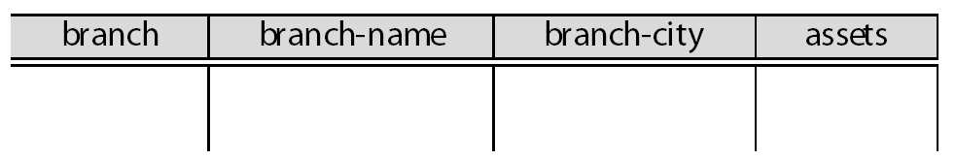
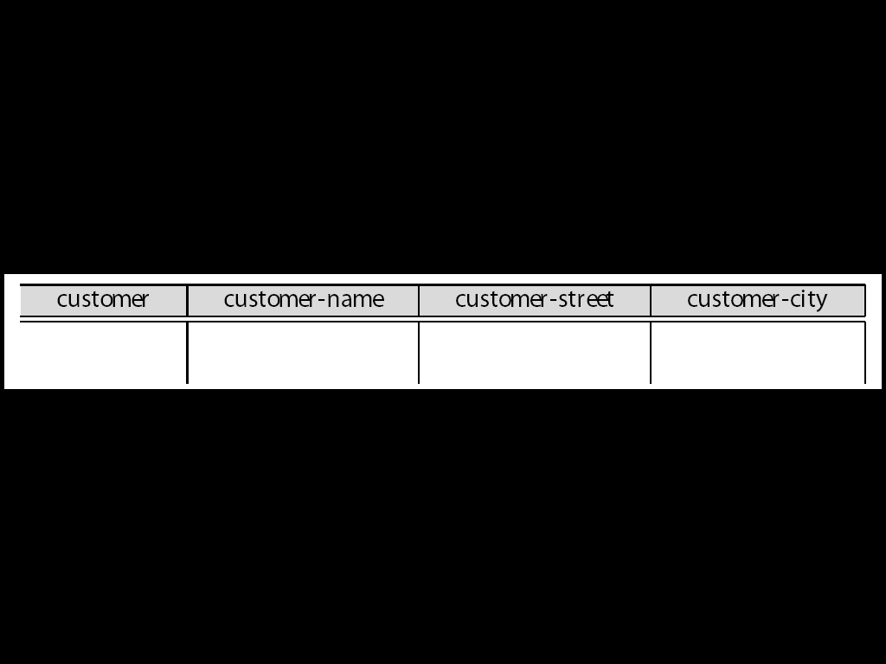
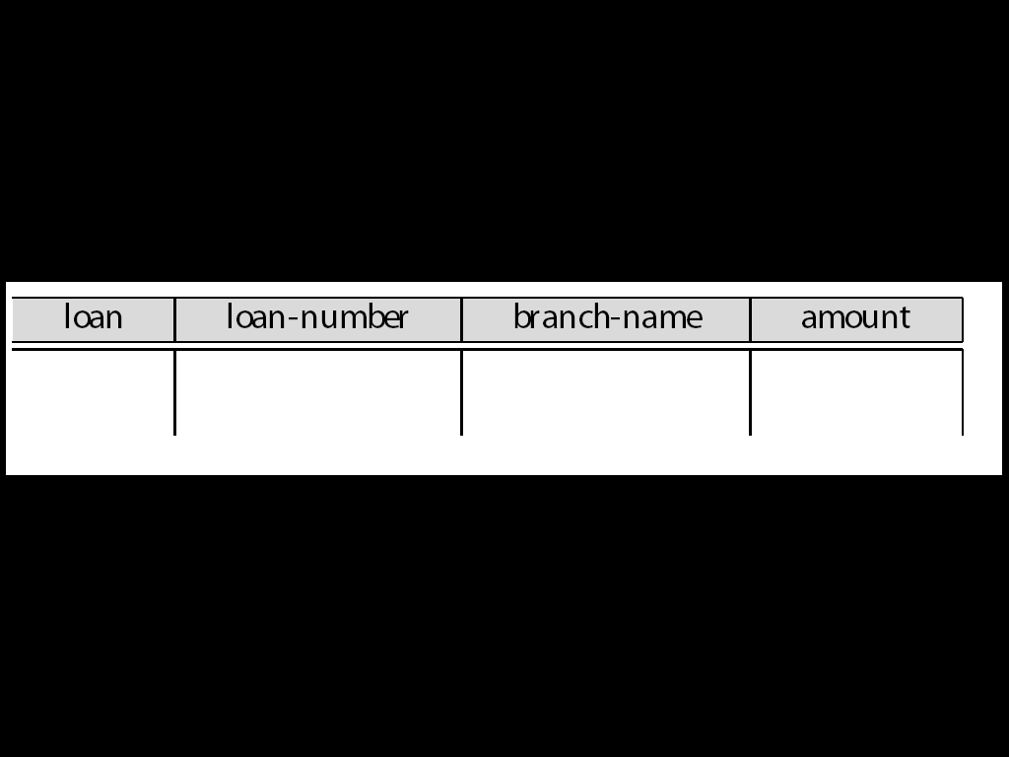
QBE Skeleton Tables for the Bank Example

Slide 47
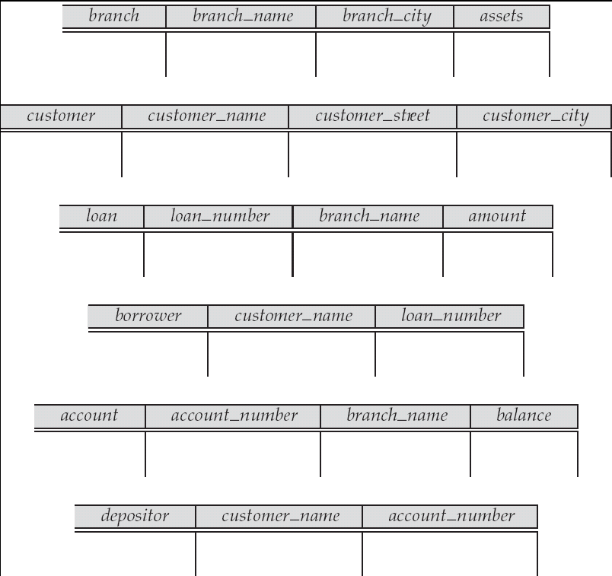
QBE Skeleton Tables (Cont.)

Slide 48
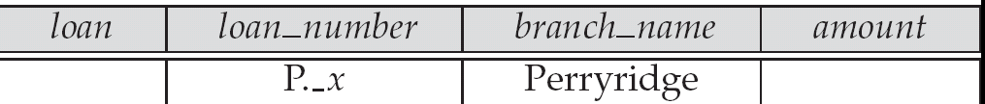

Queries on One Relation
Find all loan numbers at the Perryridge branch.
    _x is a variable (optional; can be omitted in above query)
    P. means print (display)
    duplicates are removed by default
    To retain duplicates use P.ALL

Slide 49
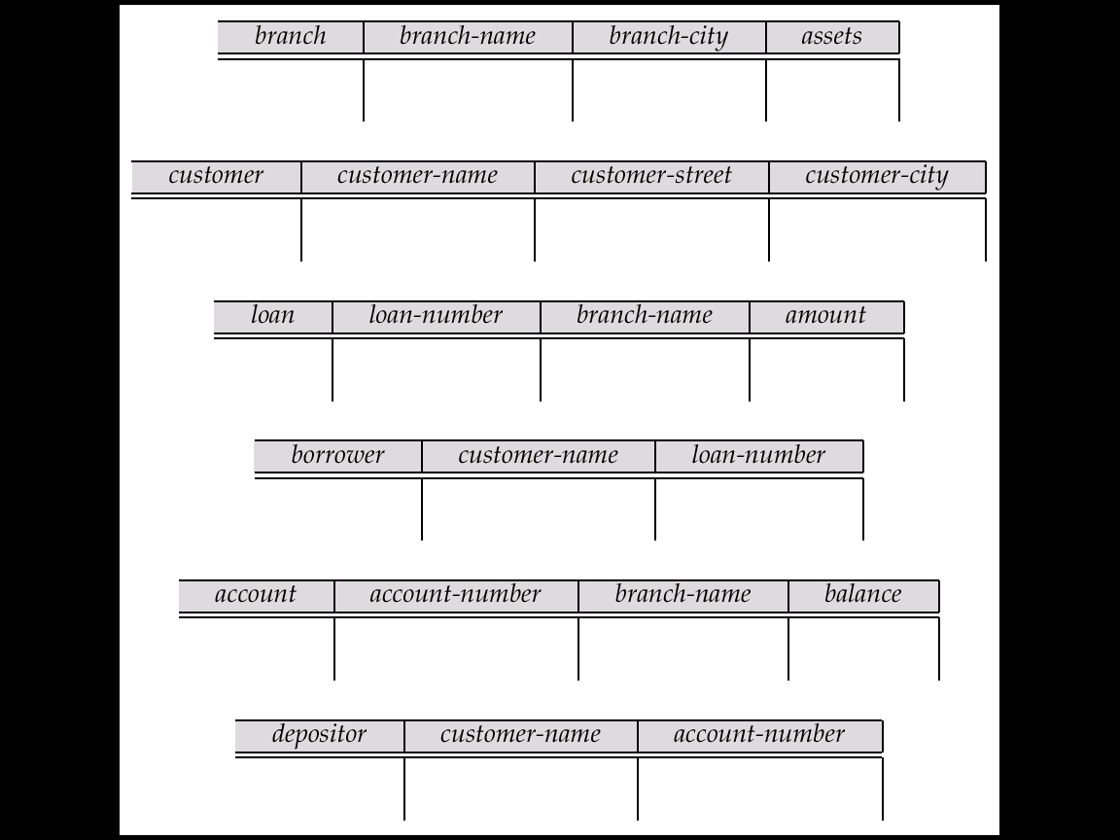
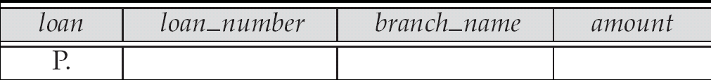
Queries on One Relation (Cont.)
Display full details of all loans
  Method 1:
P._x
P._y
P._z
  Method 2: Shorthand notation

Slide 50
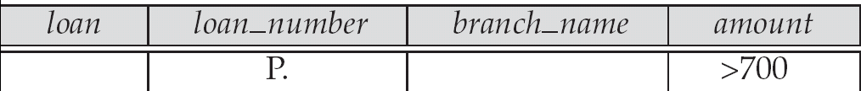
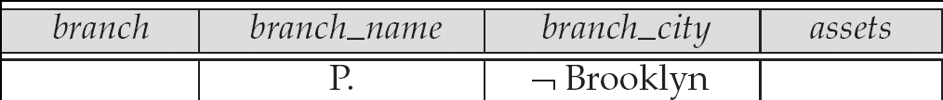
Queries on One Relation (Cont.)
Find the loan number of all loans with a loan amount of more than $700
Find names of all branches that are not located in Brooklyn

Slide 51
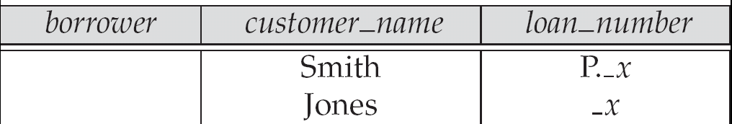
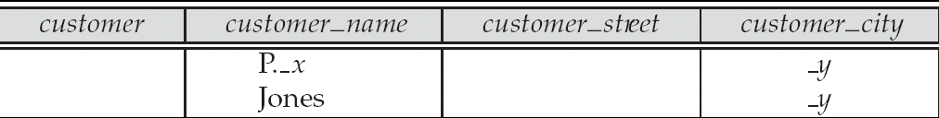
Queries on One Relation (Cont.)
Find the loan numbers of all loans made jointly to Smith and Jones.
Find all customers who live in the same city as Jones

Slide 52
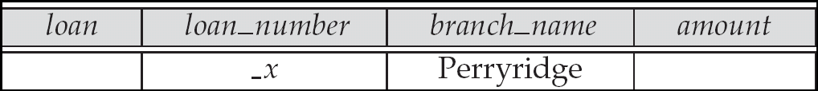
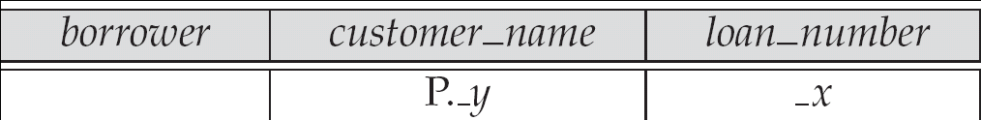
Queries on Several Relations
Find the names of all customers who have a loan from the Perryridge branch.

Slide 53
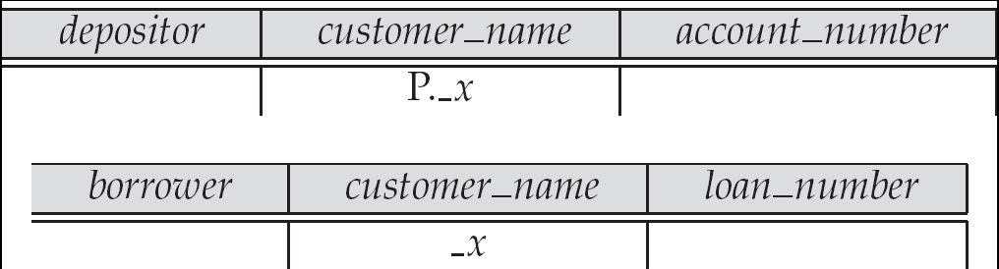
Queries on Several Relations (Cont.)
Find the names of all customers who have both an account and a loan at the bank.

Slide 54
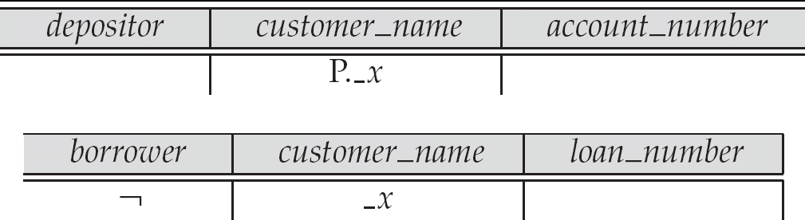
Negation in QBE
Find the names of all customers who have an account at the bank, but do not have a loan from the bank.
* ¬ means “there does not exist”

Slide 55
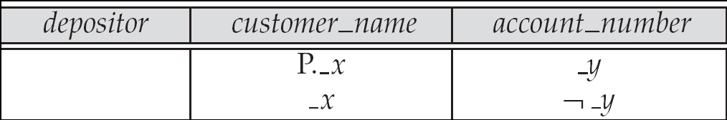
Negation in QBE (Cont.)
Find all customers who have at least two accounts.
* ¬ means “not equal to”

Slide 56
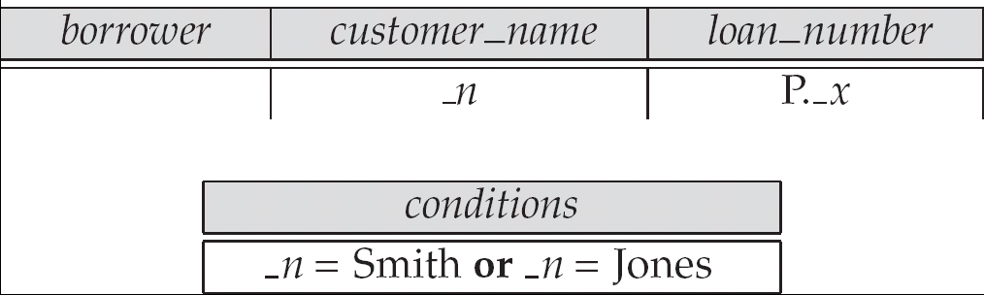
The Condition Box
Find the loan numbers of all loans made to Smith, to Jones, or to both jointly
Allows the expression of constraints on domain variables that are either inconvenient or impossible to express within the skeleton tables.
Complex conditions can be used in condition boxes.

Slide 57
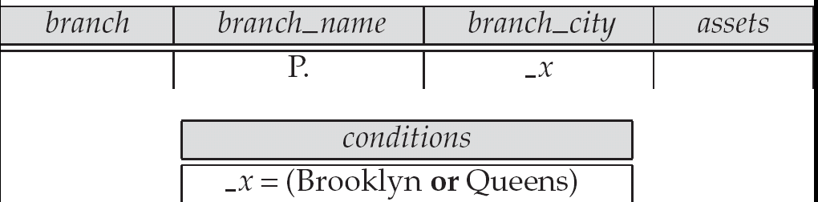
Condition Box (Cont.)
QBE supports an interesting syntax for expressing alternative values

Slide 58
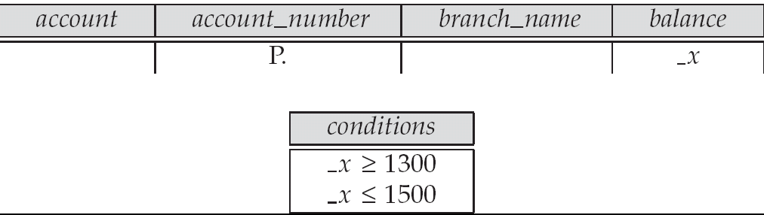
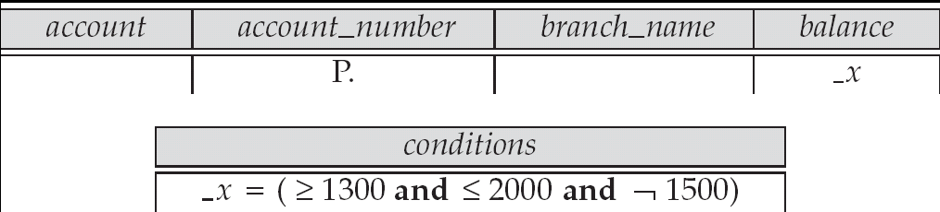
Condition Box (Cont.)
Find all account numbers with a balance greater than $1,300 and less than $1,500
Find all account numbers with a balance greater than $1,300 and less than $2,000 but not exactly $1,500.

Slide 59
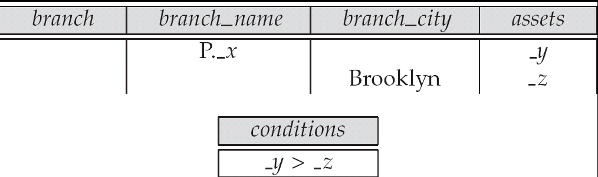
Condition Box (Cont.)
Find all branches that have assets greater than those of at least one branch located in Brooklyn

Slide 60
The Result Relation
Find the customer_name, account_number, and balance for all customers who have an account at the Perryridge branch.
  We need to:
    Join depositor and account.
    Project customer_name, account_number and balance.
  To accomplish this we:
    Create a skeleton table, called result, with attributes customer_name, account_number, and balance.
    Write the query.

Slide 61
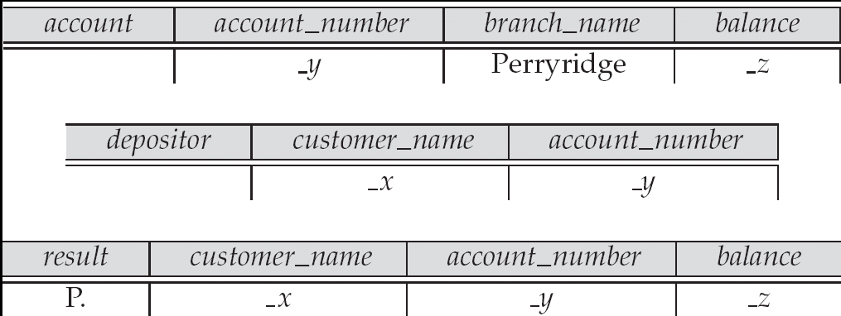
The Result Relation (Cont.)
The resulting query is:

Slide 62
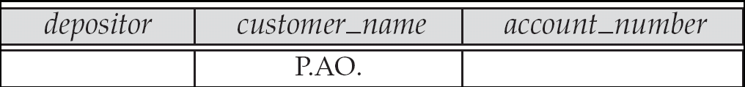
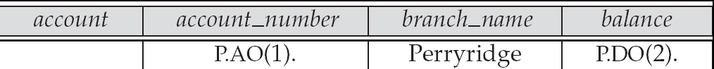
Ordering the Display of Tuples
AO = ascending order; DO = descending order.
Example: list in ascending alphabetical order all customers who have an account at the bank
When sorting on multiple attributes, the sorting order is specified by including with each sort operator (AO or DO) an integer surrounded by parentheses.
Example: List all account numbers at the Perryridge branch in ascending alphabetic order with their respective account balances in descending order.

Slide 63
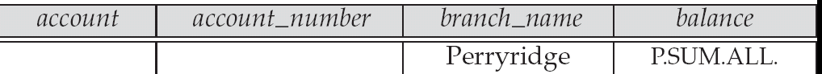
Aggregate Operations
The aggregate operators are AVG, MAX, MIN, SUM, and CNT
The above operators must be postfixed with “ALL” (e.g., SUM.ALL. or AVG.ALL._x) to ensure that duplicates are not eliminated.
Example: Find the total balance of all the accounts maintained at the Perryridge branch.

Slide 64

Aggregate Operations (Cont.)
UNQ is used to specify that we want to eliminate duplicates
Find the total number of customers having an account at the bank.

Slide 65
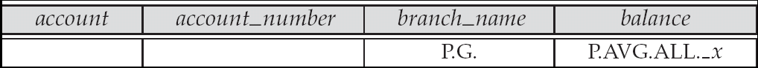
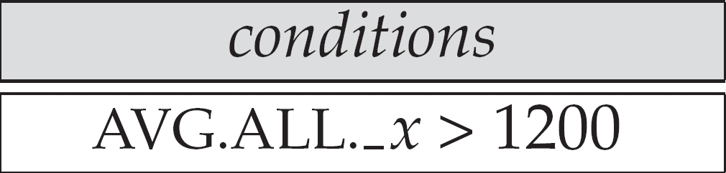
Query Examples
Find the average balance at each branch.
The “G” in “P.G” is analogous to SQL’s group by construct
The “ALL” in the “P.AVG.ALL” entry in the balance column ensures that all balances are considered
To find the average account balance at only those branches where the average account balance is more than $1,200…
we simply add the condition box:

Slide 66
Query Example
Find all customers who have an account at all branches located in Brooklyn.
  Approach: for each customer, find the number of branches in Brooklyn at which they have accounts, and compare with total number of branches in Brooklyn
  QBE does not provide subquery functionality, so both above tasks have to be combined in a single query.
    Can be done for this query, but there are queries that require subqueries and cannot always be expressed in QBE.

Slide 67
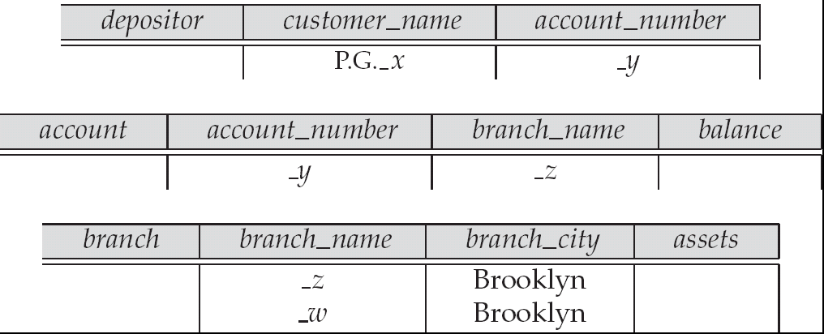
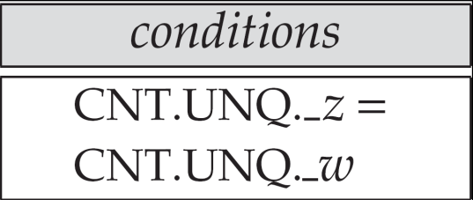
Query Example (Cont.)
CNT.UNQ._w specifies the number of distinct branches in Brooklyn. Note: The variable _w is not connected to other variables in the query
CNT.UNQ._z specifies the number of distinct branches in Brooklyn at which customer x has an account.

Slide 68
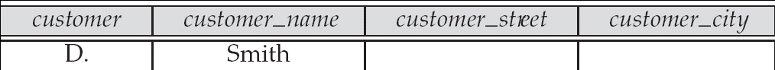
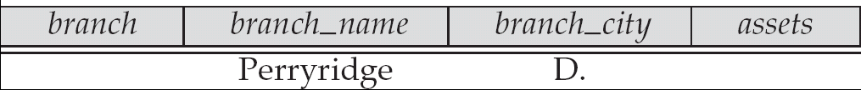
Modification of the Database – Deletion
Deletion of tuples from a relation is expressed by use of a D. command. In the case where we delete information in only some of the columns, null values, specified by –, are inserted.
Delete customer Smith
Delete the branch_city value of the branch whose name is “Perryridge”.

Slide 69
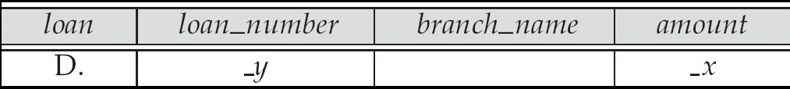
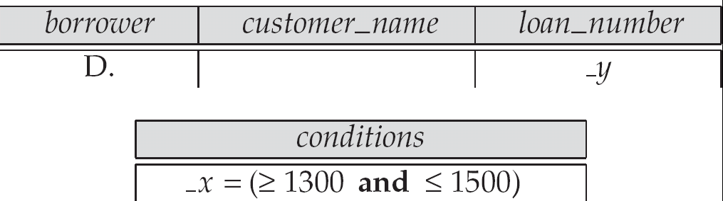
Deletion Query Examples
Delete all loans with a loan amount greater than $1300 and less than $1500.
  For consistency, we have to delete information from loan and borrower tables

Slide 70
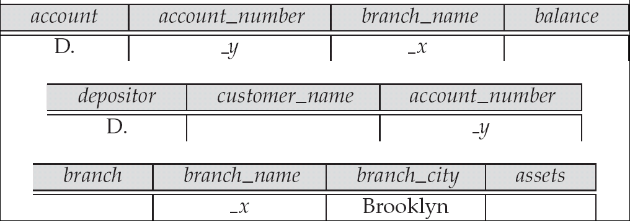
Deletion Query Examples (Cont.)
Delete all accounts at branches located in Brooklyn.

Slide 71
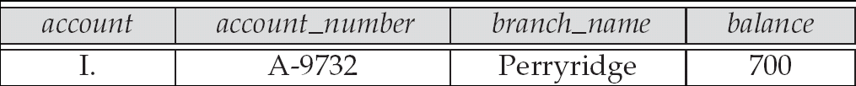
Modification of the Database – Insertion
Insertion is done by placing the I. operator in the query expression.
Insert the fact that account A-9732 at the Perryridge branch has a balance of $700.

Slide 72
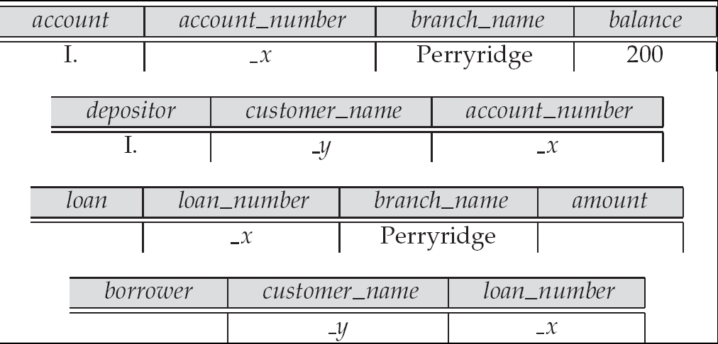
Modification of the Database – Insertion
Provide as a gift for all loan customers of the Perryridge branch, a new $200 savings account for every loan account they have, with the loan number serving as the account number for the new savings account.

Slide 73
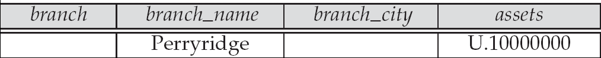
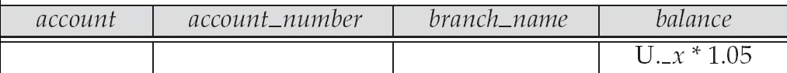
Modification of the Database – Updates
Use the U. operator to change a value in a tuple without changing all values in the tuple. QBE does not allow users to update the primary key fields.
Update the asset value of the Perryridge branch to $10,000,000.
Increase all balances by 5 percent.

Slide 74
Microsoft Access QBE
Microsoft Access supports a variant of QBE called Graphical Query By Example (GQBE)
GQBE differs from QBE in the following ways
  Attributes of relations are listed vertically, one below the other, instead of horizontally
  Instead of using variables, lines (links) between attributes are used to specify that their values should be the same.
    Links are added automatically on the basis of attribute name, and the user can then add or delete links
    By default, a link specifies an inner join, but can be modified to specify outer joins.
  Conditions, values to be printed, as well as group by attributes are all specified together in a box called the design grid

Slide 75
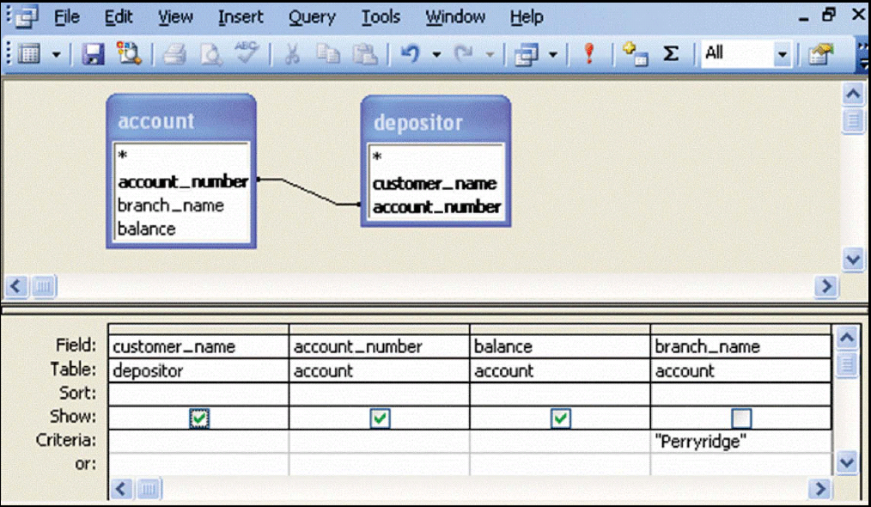
Example Queries
Find the customer_name, account_number and balance for all accounts at the Perryridge branch

Slide 76
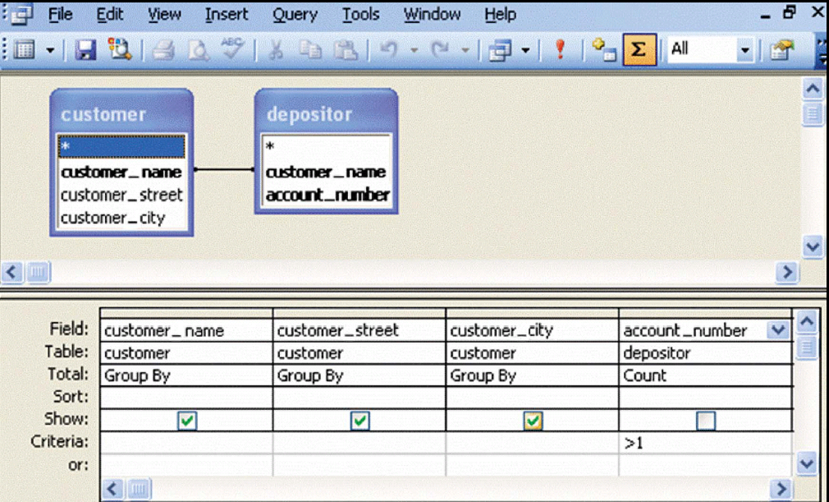
Example Queries
Find the name, street and city of all customers who have more than one account at the bank

Slide 77
Next Lecture
Entity-Relationship Model

Slide 78
End of Lecture 4

